Slide 1
Cause of Death (EDA analysis)
By-
Sumit Pandey

Slide 2
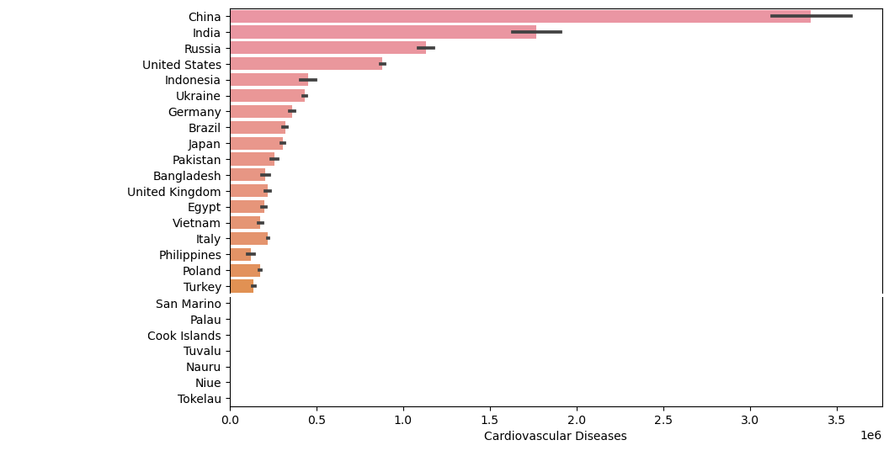
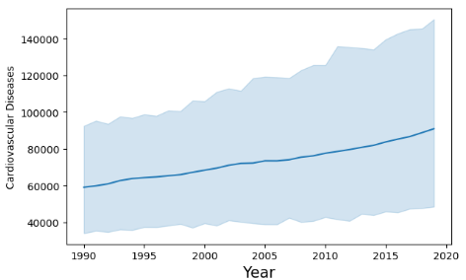
EDA analysis-
On Top 10 diseases with respect to countries and year.
Top 5 countries are China, India, Russia, the United States, and Indonesia.
Here in cardiovascular disease number of deaths increases when the year is increased.

Slide 3
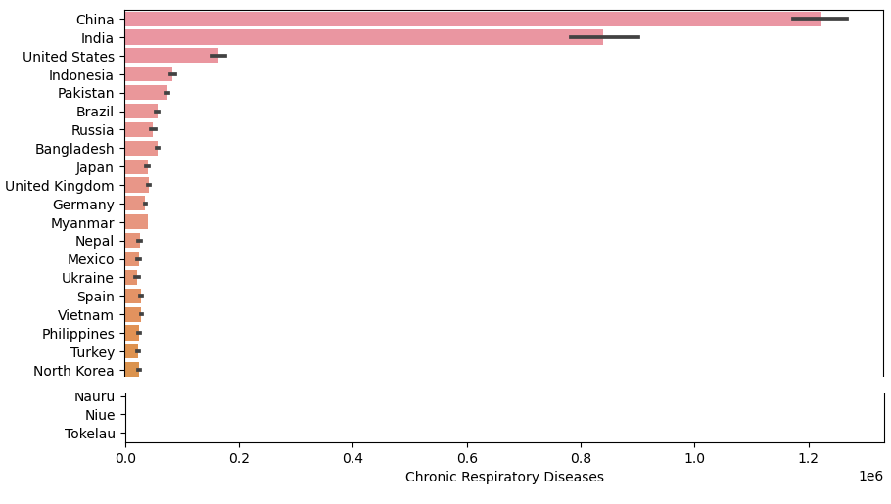
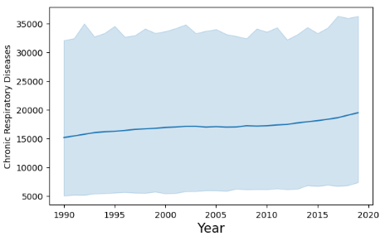
EDA analysis-
In chronic Respiratory disease number of deaths are slightly stable when the year is increased.

Slide 4
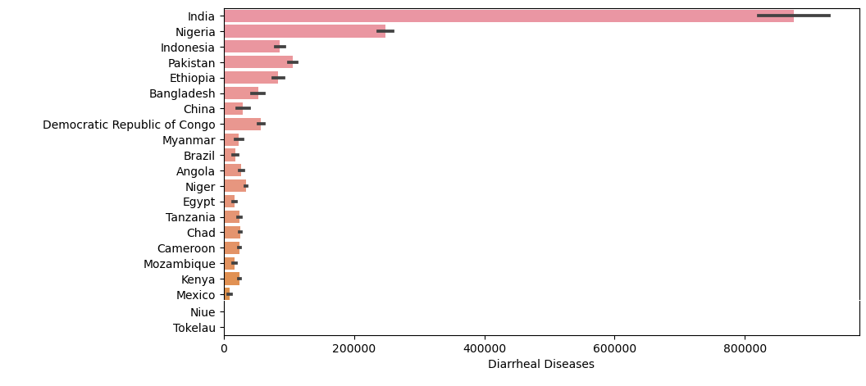
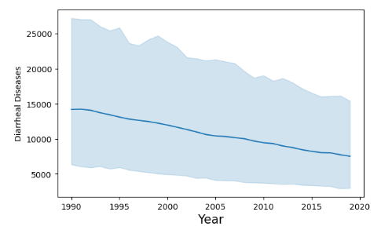
EDA analysis-
In diarrheal disease number of deaths is decreased as the year is passed.

Slide 5
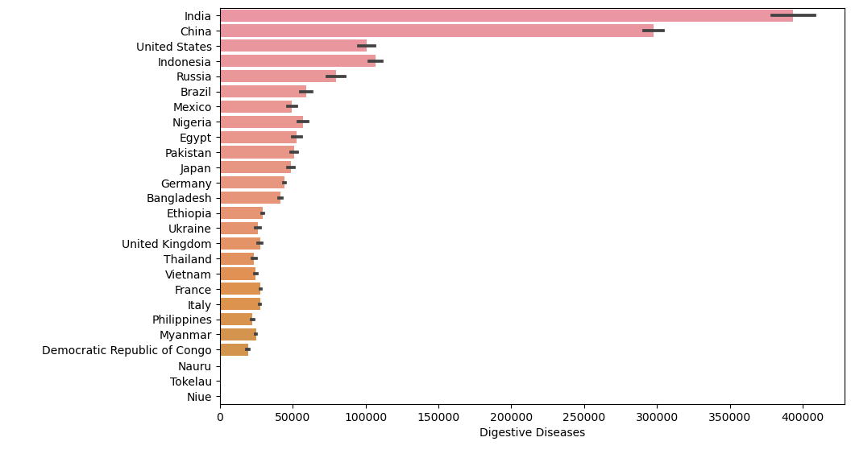
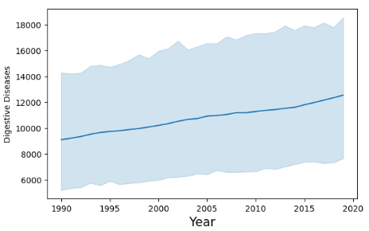
EDA analysis-
In digestive disease number of deaths is increased as the year is passed.

Slide 6
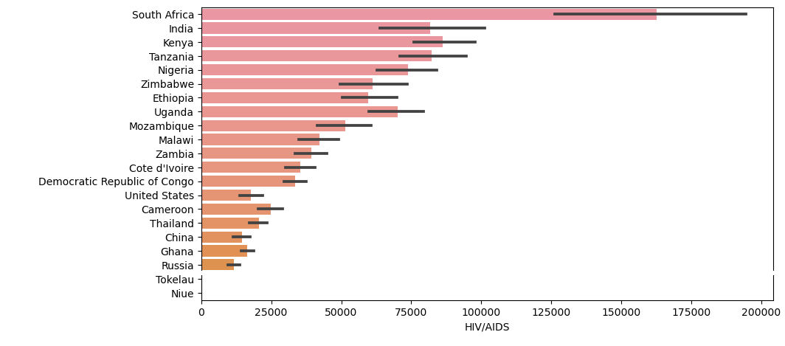
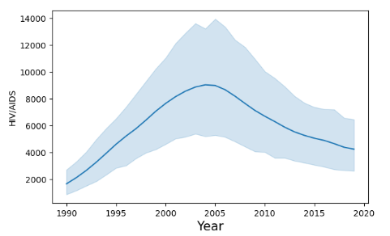
EDA analysis-
In HIV/AIDS number of deaths is increased in a particular period of years( 1995-2015).
Top 5 countries are- South Africa, India, Kenya, Tanzania, and Zimbabwe.

Slide 7
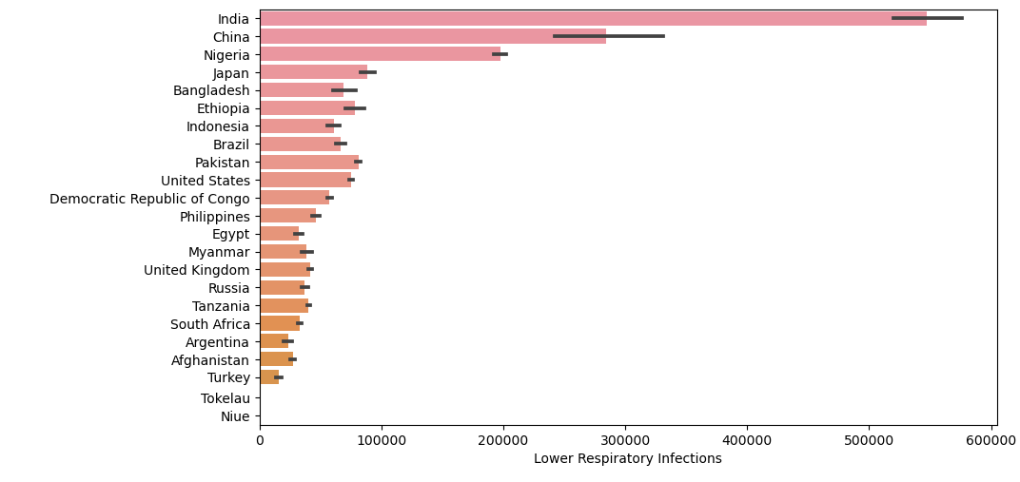
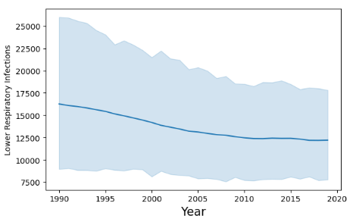
EDA analysis-
In lower respiratory infection number of deaths at the starting year is more as the year passed the number of death is slightly low.

Slide 8
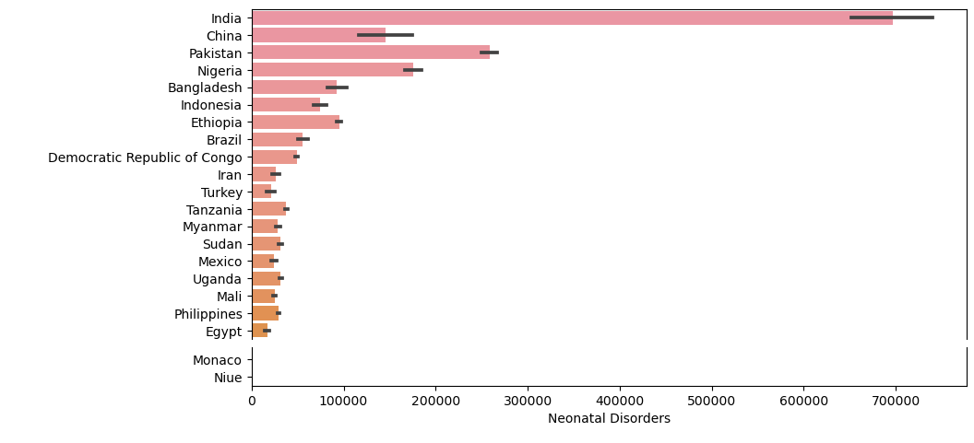
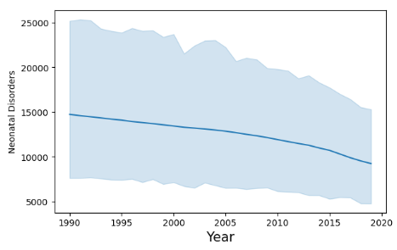
EDA analysis-
In Neonatal disorder number of deaths at the starting year is approx 15000 as the year passed the number of death slightly decreased to 10000.

Slide 9
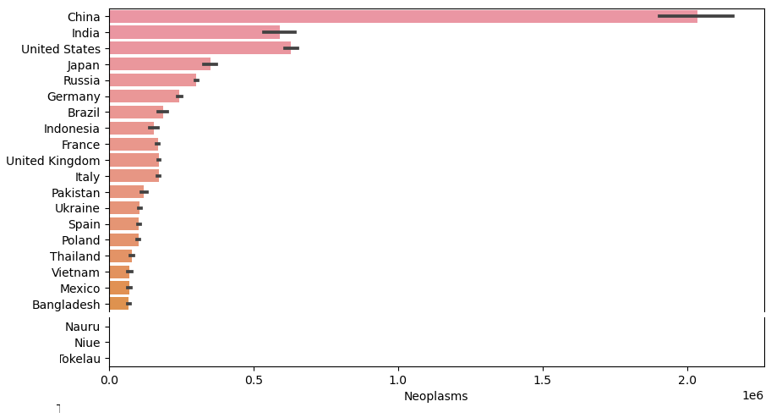
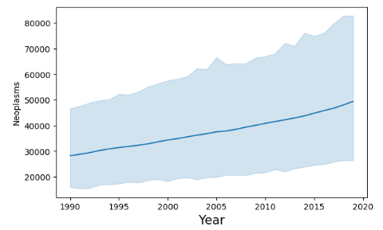
EDA analysis-
In Neoplasms number of deaths at the starting year is less as the year passed the number of death increases.

Slide 10
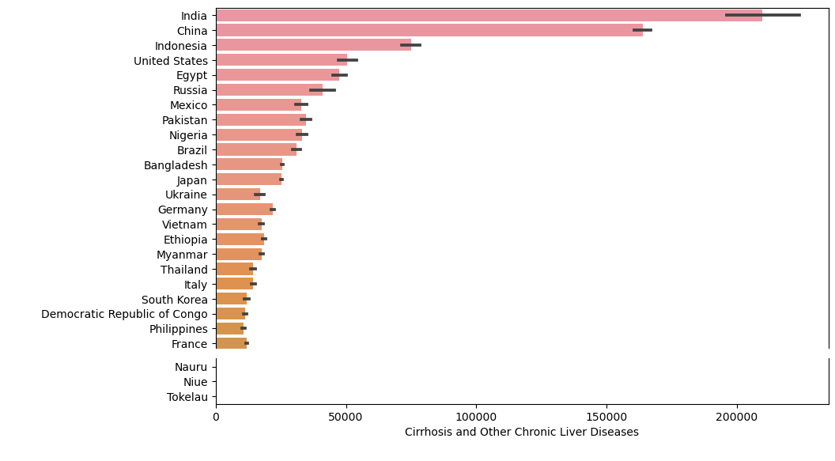
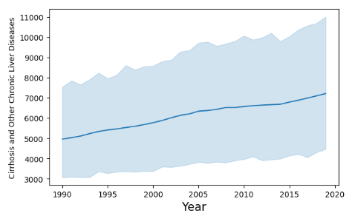
EDA analysis-
In other chronic diseases number of deaths at the starting year is less as the year passed the number of death increases.

Slide 11
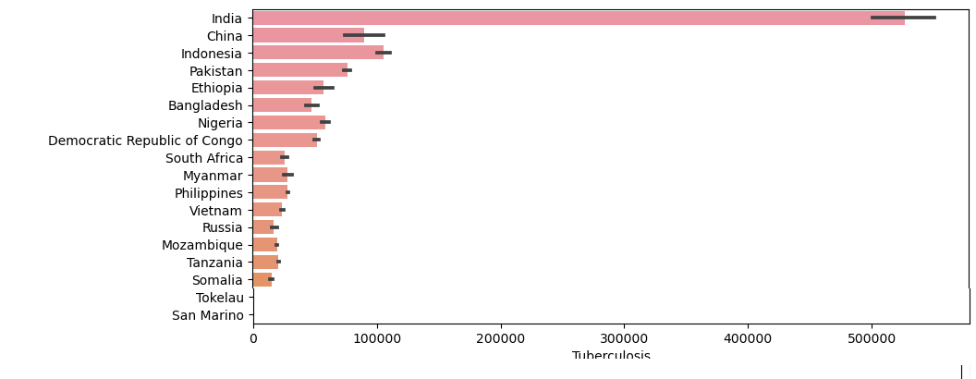
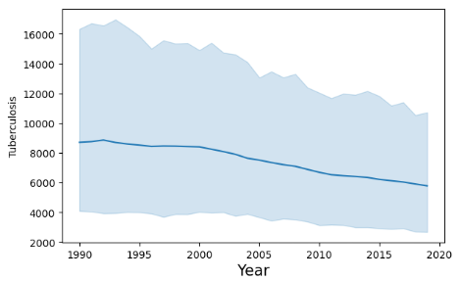
EDA analysis-
In tuberculosis number of deaths at the starting year is approx. 9000 as the year passed the number of death minimized to 6000.

Slide 12
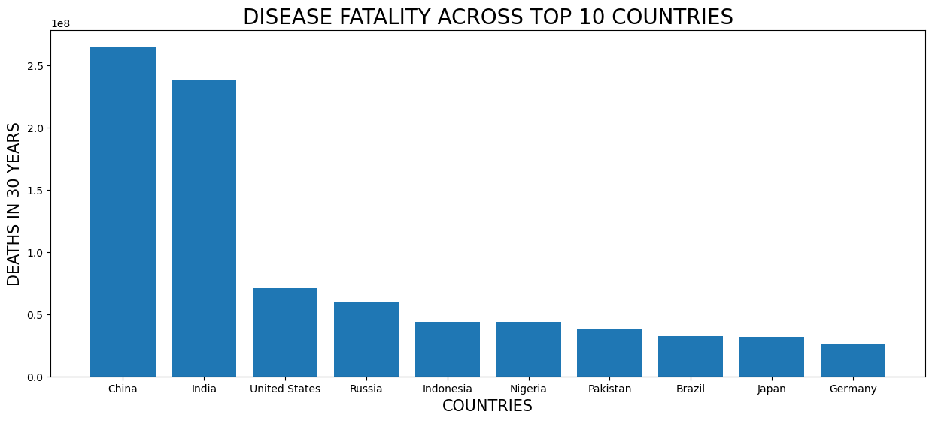
Top 10 countries having deaths in 30 years.
Here China, India, the United States, Russia, Indonesia, Nigeria, Pakistan, Brazil, Japan, and Germany had a large number of deaths in the last 30 years.

Slide 13
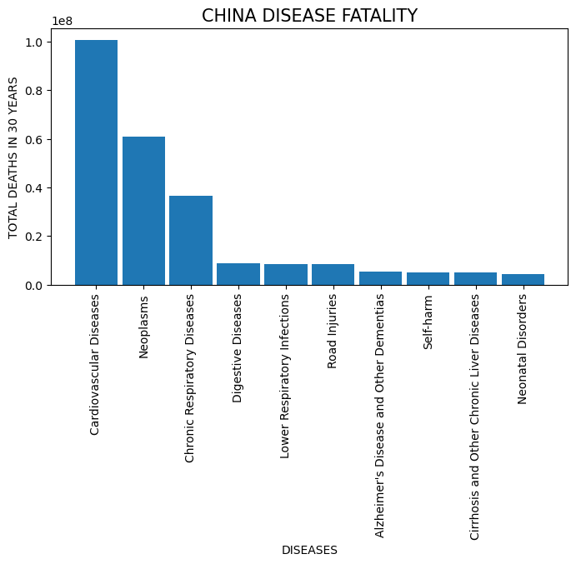
Let’s analyse them one by one according to top countries.

Slide 14
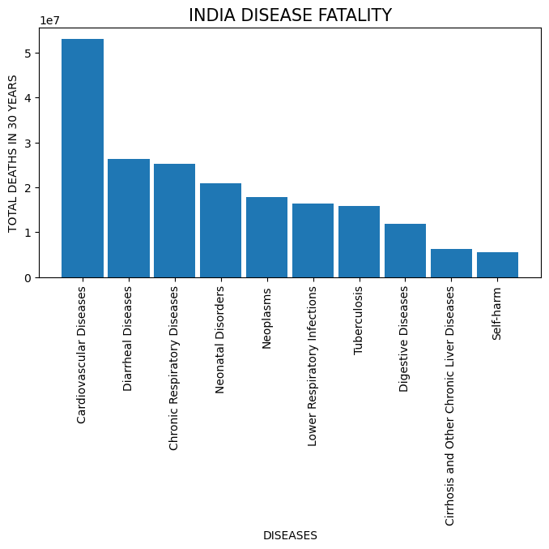

Slide 15
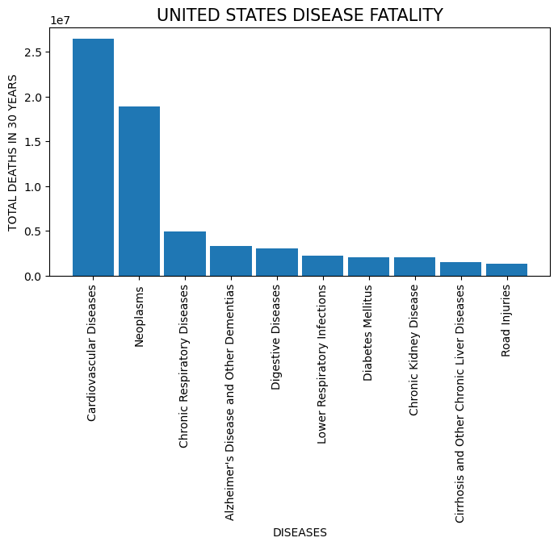
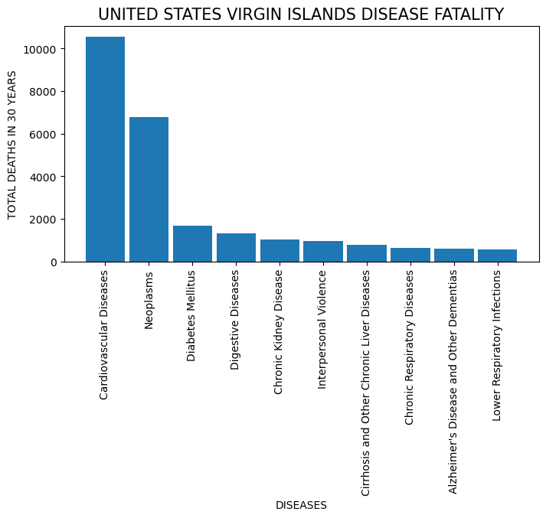

Slide 16
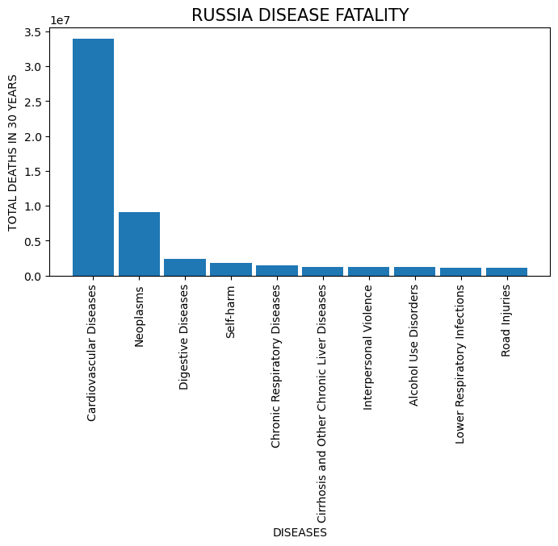

Slide 17
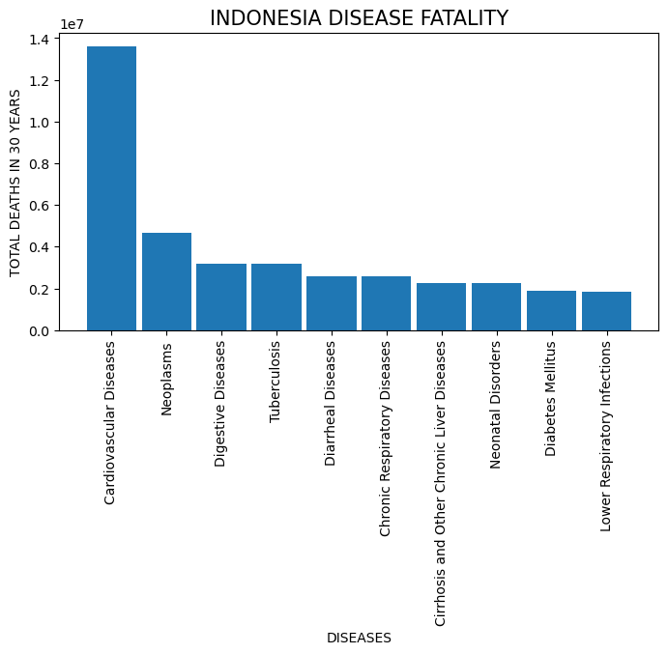

Slide 18
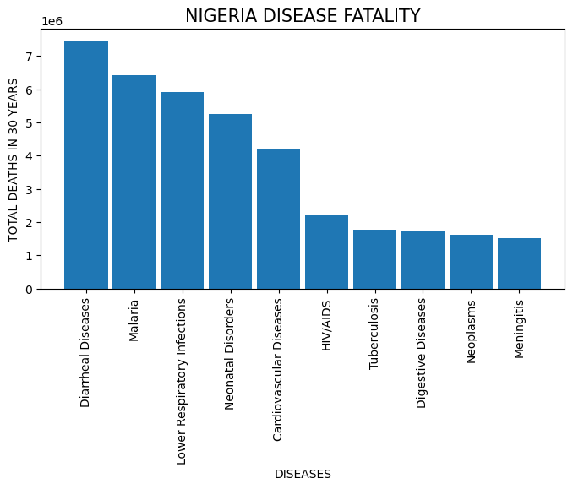

Slide 19
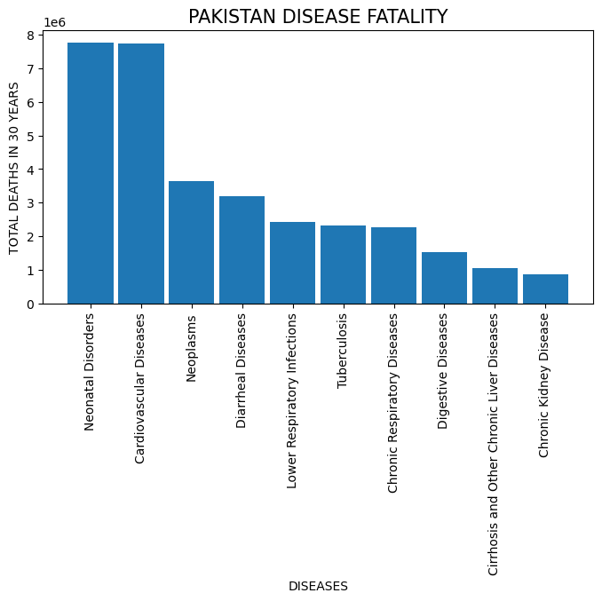

Slide 20
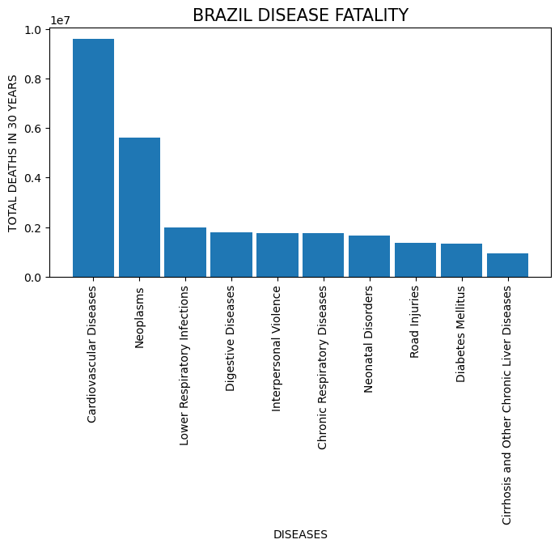

Slide 21
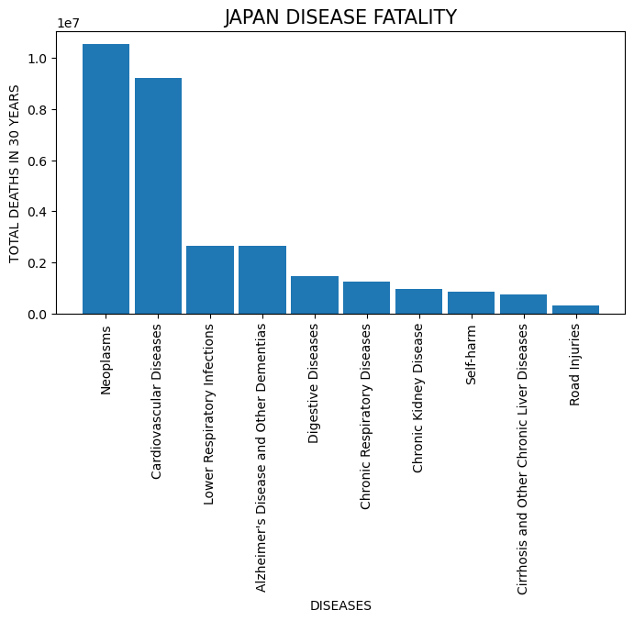

Slide 22
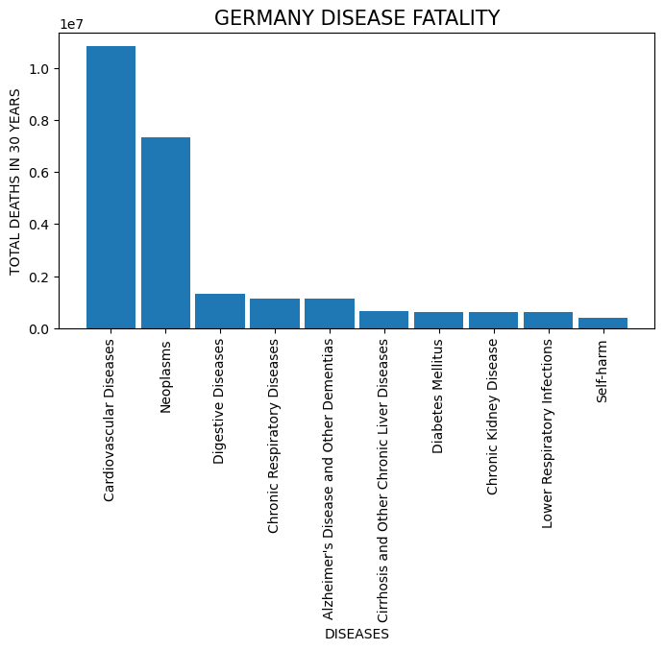

Slide 23
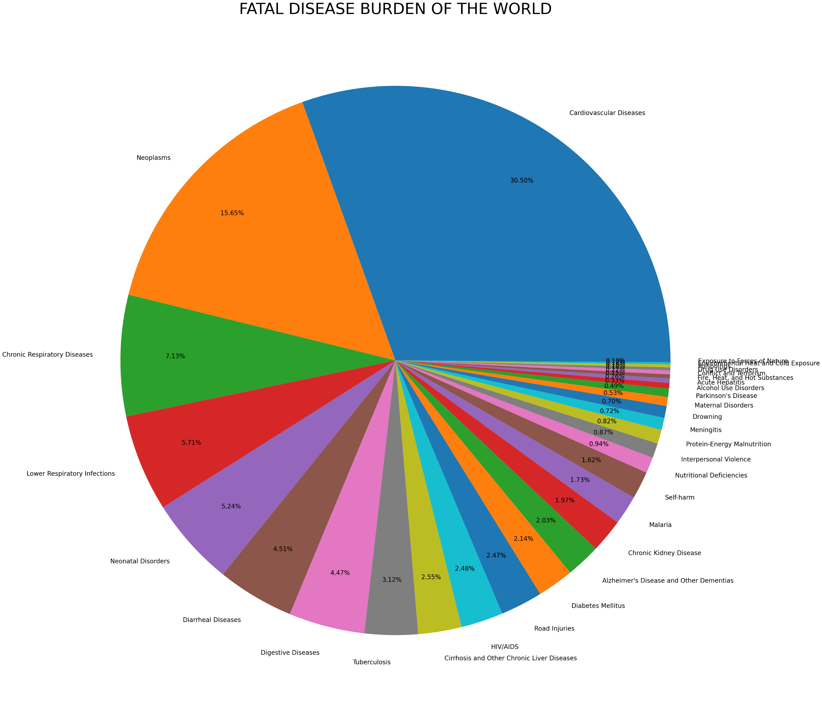

Slide 24
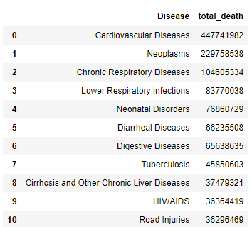
Conclusion
The top 10 diseases around the world and the number of deaths are shown in the table.
Top 10 countries that suffer from this disease are-
China
India
United States
Russia
Nigeria
Pakistan
Brazil
Japan
Germany

